Slide 1


INFOSYS
PRESENTATION

Slide 2
Team Members
1) Arnav Sharma - 500091791
2) Aryan Sharma - 500091441
3) Hitendra Sisodia - 500091910
4) Vaasundhra Singh -500091000

Slide 3
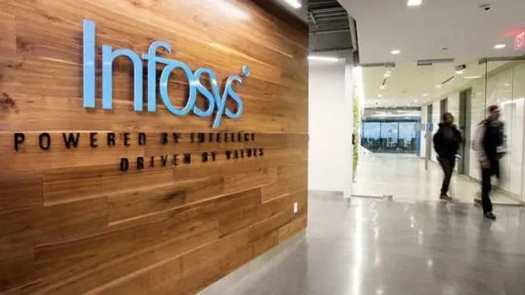

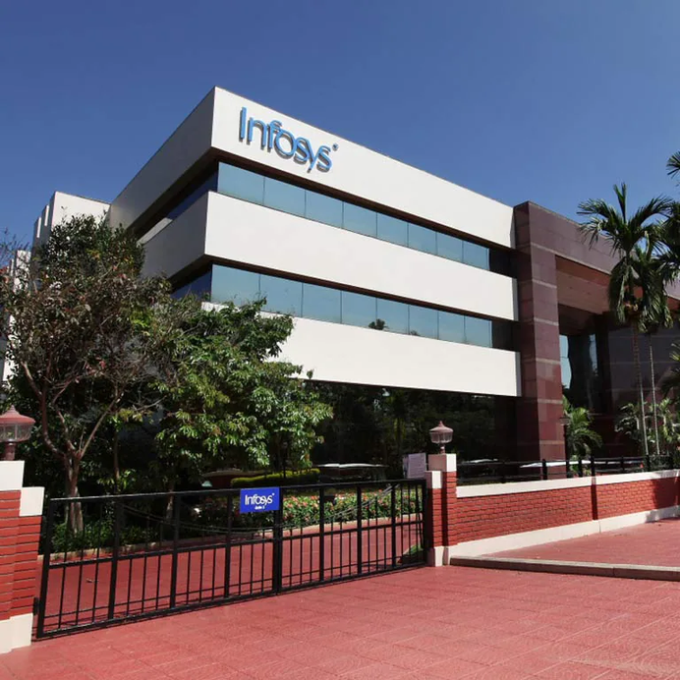
ABOUT
INFOSYS
Infosys is a global technology consulting and services company.
Founded in 1981 by N.R. Narayana Murthy and a group of six engineers in Pune, India.
Headquartered in Bangalore. Infosys is the second-largest Indian IT company, after Tata Consultancy Services, by 2020 revenue figures.
On 24 August 2021, Infosys became the fourth Indian company to reach US$100 billion in market capitalization. It is one of the top Big Tech (India) companies.
Infosys provides a wide range of services, including IT consulting, software development, maintenance, and outsourcing.
The company is known for its commitment to innovation, client-centric approach, and emphasis on corporate governance.

Slide 4
REQUIREMENT DRIVES
On Campus Hiring:
Conducted by Infosys for hiring freshers from colleges.
Hackwithinfy
HackWithinfy is a competitive coding competition for second year to final year students across India.
Infytq Exam
The Infytq exam is a competitive assessment administered by Infosys after clearing you get an opportunity to be interviewed directly for a job at Infosys
Off Campus Hiring
Conducted by Infosys for hiring freshers from colleges who are not part of the campus placement process.

Slide 5

DOES IT COME TO OUR CAMPUS - YES
PROFILES OFFERED BY INFOSYS
Assistant System Engineer - 3.6 LPA
Digital Specialist Programmer - 6.25 LPA
Specialist Programmer - 9.5 LPA

Slide 6
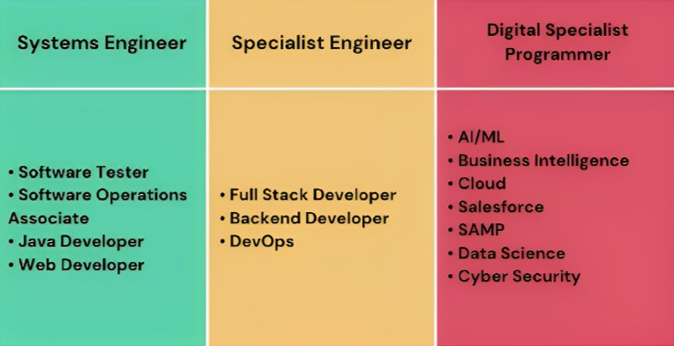

WORK YOU GET IN SPECIFIC PROFILE OFFERED

Slide 7

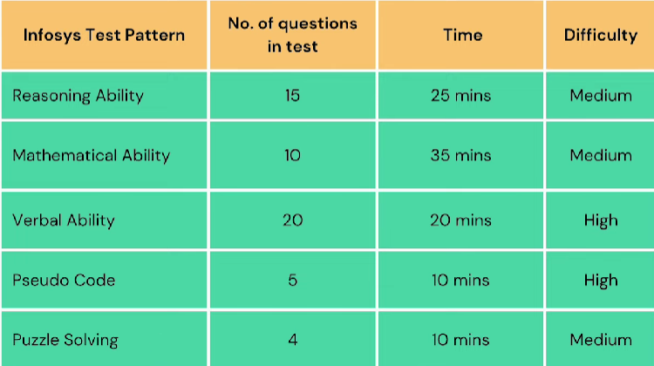


SYSTEM ENGINEER ONLINE TEST PATTERN
EACH SECTION WILL HAVE A SEPARATE CUT OFF

Slide 8
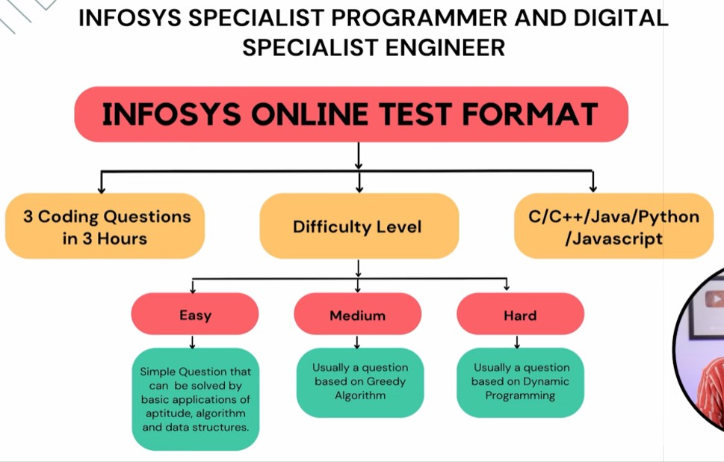
ONLINE TEST FORMAT

Slide 9
INFOSYS INTERVIEW PROCESS
• Concepts of OOPs (Object Oriented Programming) Must know basics of these if you have written in resume.
• DBMS and OS if written in resume while submitting.Must know basics of these if you have written in resume.
• In Data Structures - More focus on Topics like Arrays Linked Lists, Stacks(basic), Queues(basic), Trees(basic), Graphs (basic),Searching and Sorting.

Slide 10
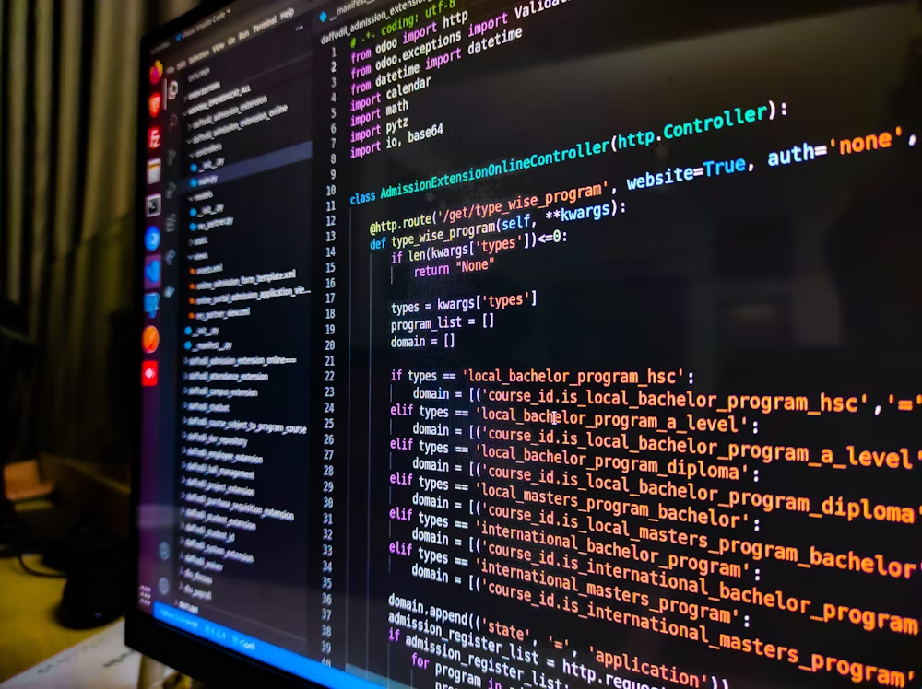
ELIGIBILITY CRITERIA
Infosys usually requires candidates to have a minimum percentage or grade in their academic qualifications. This could include a specific GPA or a particular percentage in 10th, 12th, and/or undergraduate studies.
Candidates must have scored a minimum fo 60% in 10 and 12 Board Exams. The candidates must have 65% or 6.5 CGPA in their Graduation degree.

Slide 11


STATES HAVING INFOSYS OFFICES IN INDIA
KARNATAKA TAMIL NADU
WEST BENGAL MAHARASHTRA
ODISHA
UTTAR PRADESH
PUNJAB
JAMMU & KASHMIR
MADHYA PRADESH
DELHI
KERALA
RAJASTHAN
CHANDIGARH
TELANGANA
HARYANA

Slide 12
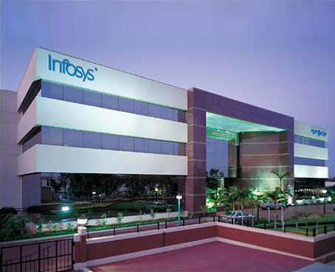
SKILLSET REQUIRED
Programming Languages:
Proficiency in one or more programming languages such as Java, Python, C++, or others depending on the role
Database Management:
Understanding of database management systems (SQL, MySQL) and database design.
Data Structures and Algorithms:
Strong understanding and application of data structures and algorithms.
Operating Systems:
Understanding of operating systems, including Linux and Windows.

Slide 13
WHERE TO LEARN REQUIERD SKILLS
DSA A-Z Playlist by Take You Forward
https://youtube.com/playlist?list=PLgUwDviBIf0oF6QL8m22w1hIDC1vJ_BHz&si=qwA4sbho8_kQtESY
Aptitude Preparation
https://cpt.hitbullseye.com/Infosys-Aptitude-Questions.php
simplilearn.com
interviewbit.com

Slide 14
SAMPLE INTERVIEW QUETIONS
Programming and Data Structures:
Explain the difference between an array and a linked list. When would you use one over the other?
Write a program to find the factorial of a number.
Implement a stack using an array or linked list.
Explain the concept of dynamic programming and provide an example.
Algorithms:
Explain the working of quicksort and its time complexity.
Solve the classic problem of finding the nth Fibonacci number.
Describe Dijkstra's algorithm and its application.

Slide 15
SAMPLE QUESTIONS CONT.
Database Management:
Write an SQL query to retrieve the second highest salary from a table.
Explain the differences between INNER JOIN and OUTER JOIN.
What is normalization, and why is it important in database design?
Operating Systems:
Describe the purpose of an operating system.
Explain the difference between a process and a thread.
What is virtual memory, and how does it work?

Slide 16
THANK YOU

